Slide 1
Computer Organization and Architecture
INSTRUCTION PIPELINING
by
Upendra Mishra
(B.Tech., M.Tech., UGC-Net, Ph.D.(P))
KIET Group of Institutions

Slide 2
CONTENTS
INSTRUCTION PIPELINING

Slide 3
INSTRUCTION PIPELINING
Pipeline processing can occur not only in the data stream but in the instruction stream as well.
Most of the digital computers with complex instructions require instruction pipeline to carry out operations like fetch, decode and execute instructions.
An instruction pipeline reads consecutive instruction from memory while previous instructions are being executed in other segments. This cause the instruction fetch and execute phase to overlap and perform simultaneous operations.

Slide 4
INSTRUCTION PIPELINING
Instructions are inserted into FIFO Buffer so that they can be executed by means of a first-in, first-out buffer.
Thus, an instruction stream can be placed in a queue, waiting for decoding and processing by the execution segment.

Slide 5
INSTRUCTION PIPELINING
In general, the computer needs to process each instruction with the following sequence of steps.
1. Fetch instruction from memory.
2. Decode the instruction.
3. Calculate the effective address.
4. Fetch the operands from memory.
5. Execute the instruction.
6. Store the result in the proper place.

Slide 6
DETAILS OF A FOUR-SEGMENT INSTRUCTION PIPELINE
Segments | Segments Description
Segment 1: | The instruction fetch segment can be implemented using first in, first out (FIFO) buffer.
Segment 2: | The instruction fetched from memory is decoded in the second segment, and eventually, the effective address is calculated in a separate arithmetic circuit.
Segment 3: | An operand from memory is fetched in the third segment.
Segment 4: | The instructions are finally executed in the last segment of the pipeline organization.

Slide 7
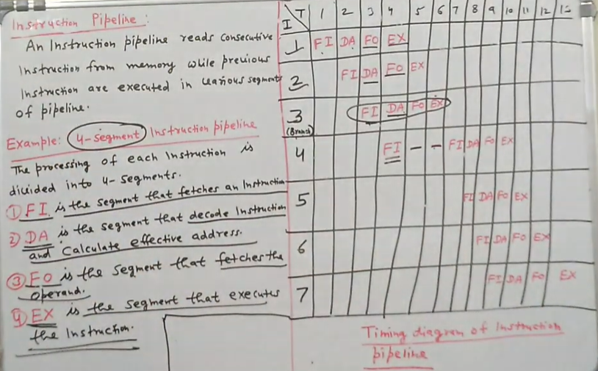


Slide 8
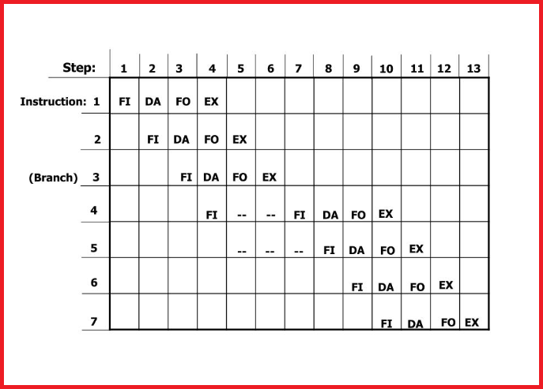
TIMING OF INSTRUCTION PIPELINE

Slide 9
INSTRUCTION PIPELINE CONFLICTS
In general, there are three major difficulties that cause the instruction pipeline to deviate from its normal operation.
1. Resource conflicts caused by access to memory by two segments at the same time. Most of these conflicts can be resolved by using separate instruction and data memories.
2. Data dependency conflicts arise when an instruction depends on the result of a previous instruction, but this result is not yet available. It can be handled by hardware interlocks, operand forwarding, and delayed load.

Slide 10
INSTRUCTION PIPELINE CONFLICTS
3. Branch difficulties arise from branch and other instructions that change the value of PC. It can be handled by prefetch target instruction, branch target buffer, loop buffer, branch prediction, and delayed branch.

Slide 11
References
Computer System Architecture - M. Mano , 3rd Edition.

Slide 12
Thank
You

